Slide 1

Climate Change Monitoring and Analysis
“Stay ahead of climate threats with our cutting-edge Climate Change Monitoring and Analysis platform.

Slide 2
Introduction
Climate Change Monitoring & Analysis Project is to comprehensively understand environmental dynamics, particularly focusing on climate change phenomena
The project seeks to:
Monitor
Analyze

Slide 3
Weather APP

Slide 4
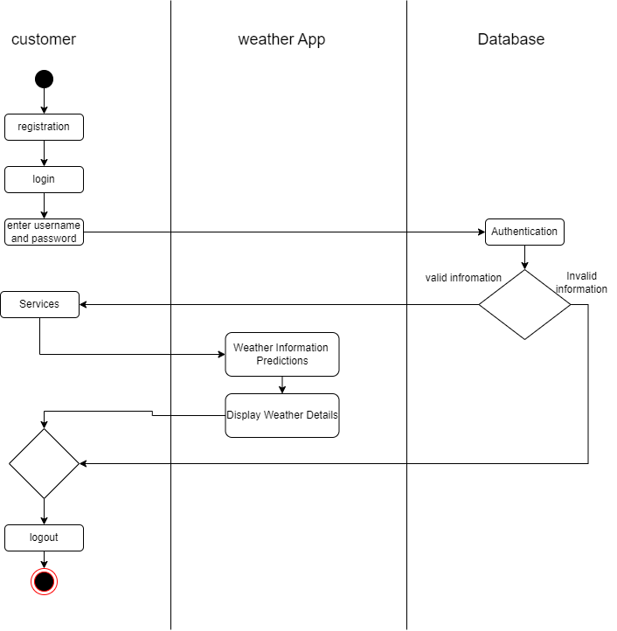

Slide 5
Home page
First view of user
HOME
about
services
login

Slide 6
Registration and Login
USER
APP
Database
registration
Username/password
stores
Login
Login details
Validation
authorize
Services

Slide 7
Services
Weather Information
Weather Prediction
Current weather
5 days forecast
Machine learning model

Slide 8
Weather Information
USER
APP
API
Weather information
Weather information
API Used: Open Weather API

Slide 9
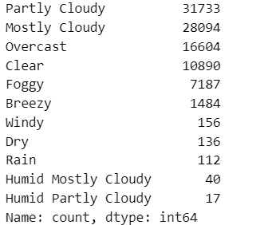
Weather Prediction
Procedure for ml model
Import dataset
Analyzing dataset
Data preprocessing
Model preparation
Model extraction
Connecting model with Interface
Dataset used: seattle-weather.csv

Slide 10
Conclusion
The Climate Change Monitoring & Analysis Project represents a significant endeavor in the ongoing pursuit of understanding and addressing climate change. Through meticulous monitoring, rigorous analysis, and interdisciplinary collaboration, we have gained valuable insights into the complexities of environmental dynamics.

